Slide 1
A Biobanking Ontology and an Informed Consent Ontology Developed For and With Subject Matter Experts
Helena Ellis, Director of Biobanking Education and Outreach, Department of Pathology, Duke University
Jie Zheng, Senior Research Investigator, Institute for Biomedical Informatics, Perelman School of Medicine,
University of Pennsylvania
Notes:
Final Helena

Slide 2
Today’s Presentation
Self-Introductions
Challenges with biobanking data
What is an ontology
questions
Development of biobanking ontology
questions
How to implement
Next steps
Time for questions/ discussion
Notes:
Final Helena

Slide 3
Today’s Presentation
Self-Introductions
Challenges with biobanking data
What is an ontology
questions
Development of biobanking ontology
questions
How to implement
Next steps
Time for questions/ discussion
Notes:
Final Helena

Slide 4

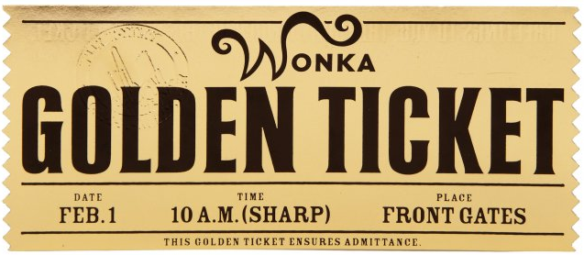
Cohort Identification The Golden Ticket
Criteria: sample type, collection, processing and storage conditions, consent permissions and restrictions, patient demographics, diagnoses, treatments and medications
PROBLEMS
Inconsistent representation of Biobank data
How many SAMPLES available? Multiple meanings for same word.
Single specimen
“Bag” of specimens collected from same person at same time
To collect a specimen
Data in different, disparate systems and schemas
Notes:
Final
One example, other terms in use at Duke
Other systems there is same problem
Other institutions are struggling with same issue
Same word with different meanings- where query across systems will not get the right answer

Slide 5
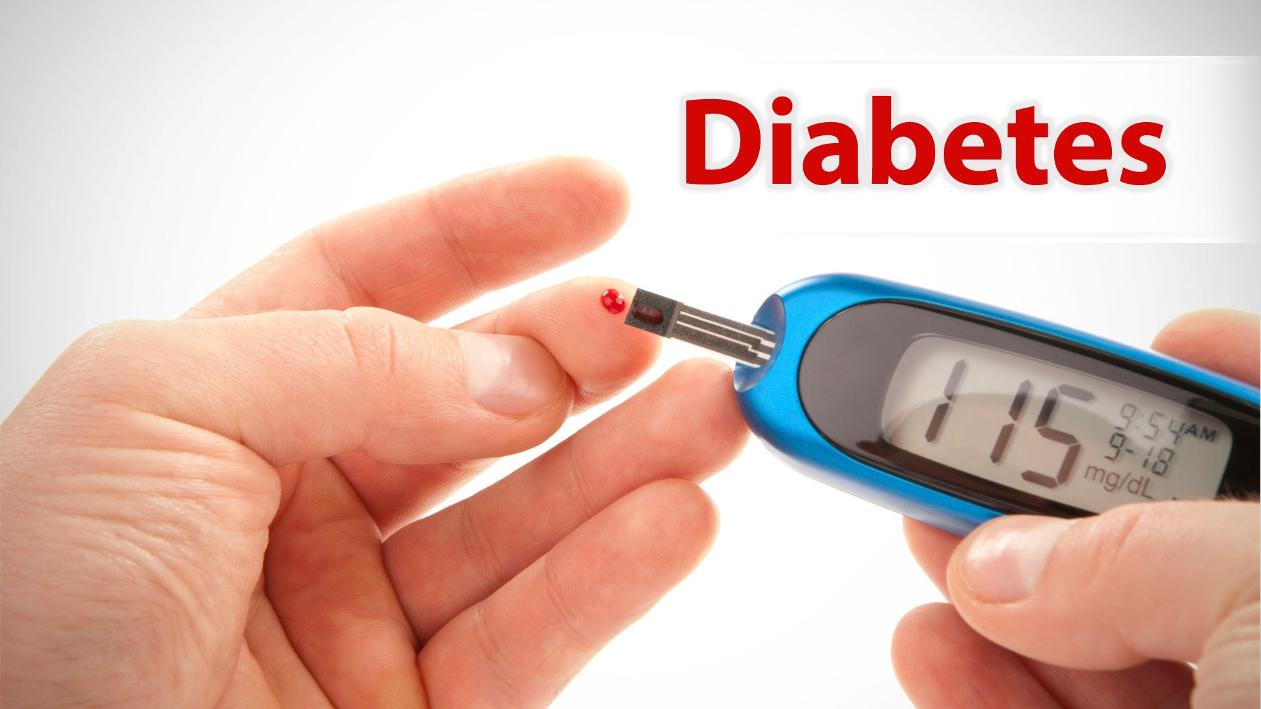
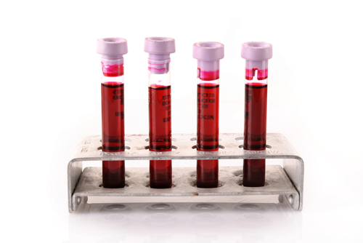

Cohort Identification Challenge at UPenn
Patients (cases) with Type 2 diabetes that have taken a statin 5 to 250 days prior to specimen collection.
Patients (controls) with Type 2 diabetes who have never taken statins.
Match cases and controls on basic demographic data (age, BMI, gender, race) collected at the time of recruitment.
All must have an EDTA blood or DNA specimen and consented to re-contact.
Data in different, disparate databases
These problems can be solved by applying an ONTOLOGY
Notes:
Final helena

Slide 6
Today’s Presentation
Self-Introductions
Challenges with (biobanking) data
What is an ontology
questions
Development of biobanking ontology
questions
How to implement
Next steps
Time for questions/ discussion
Notes:
Final Helena

Slide 7
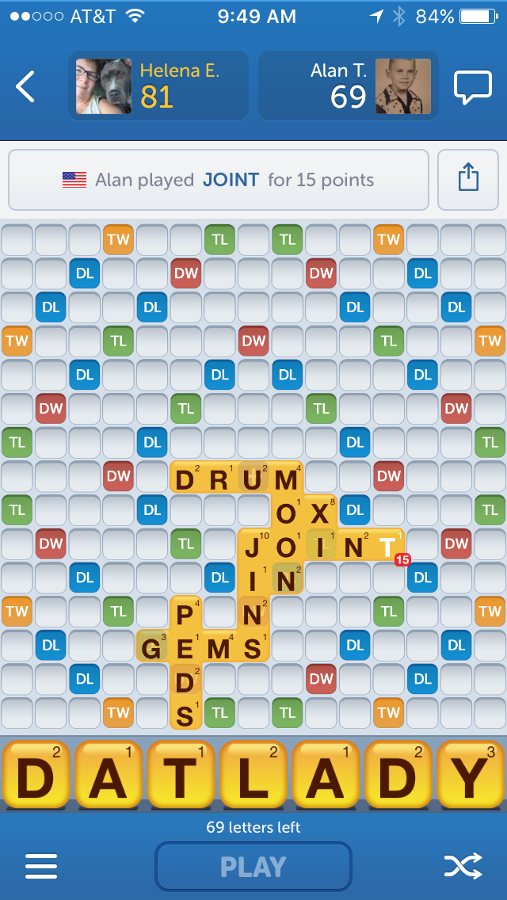
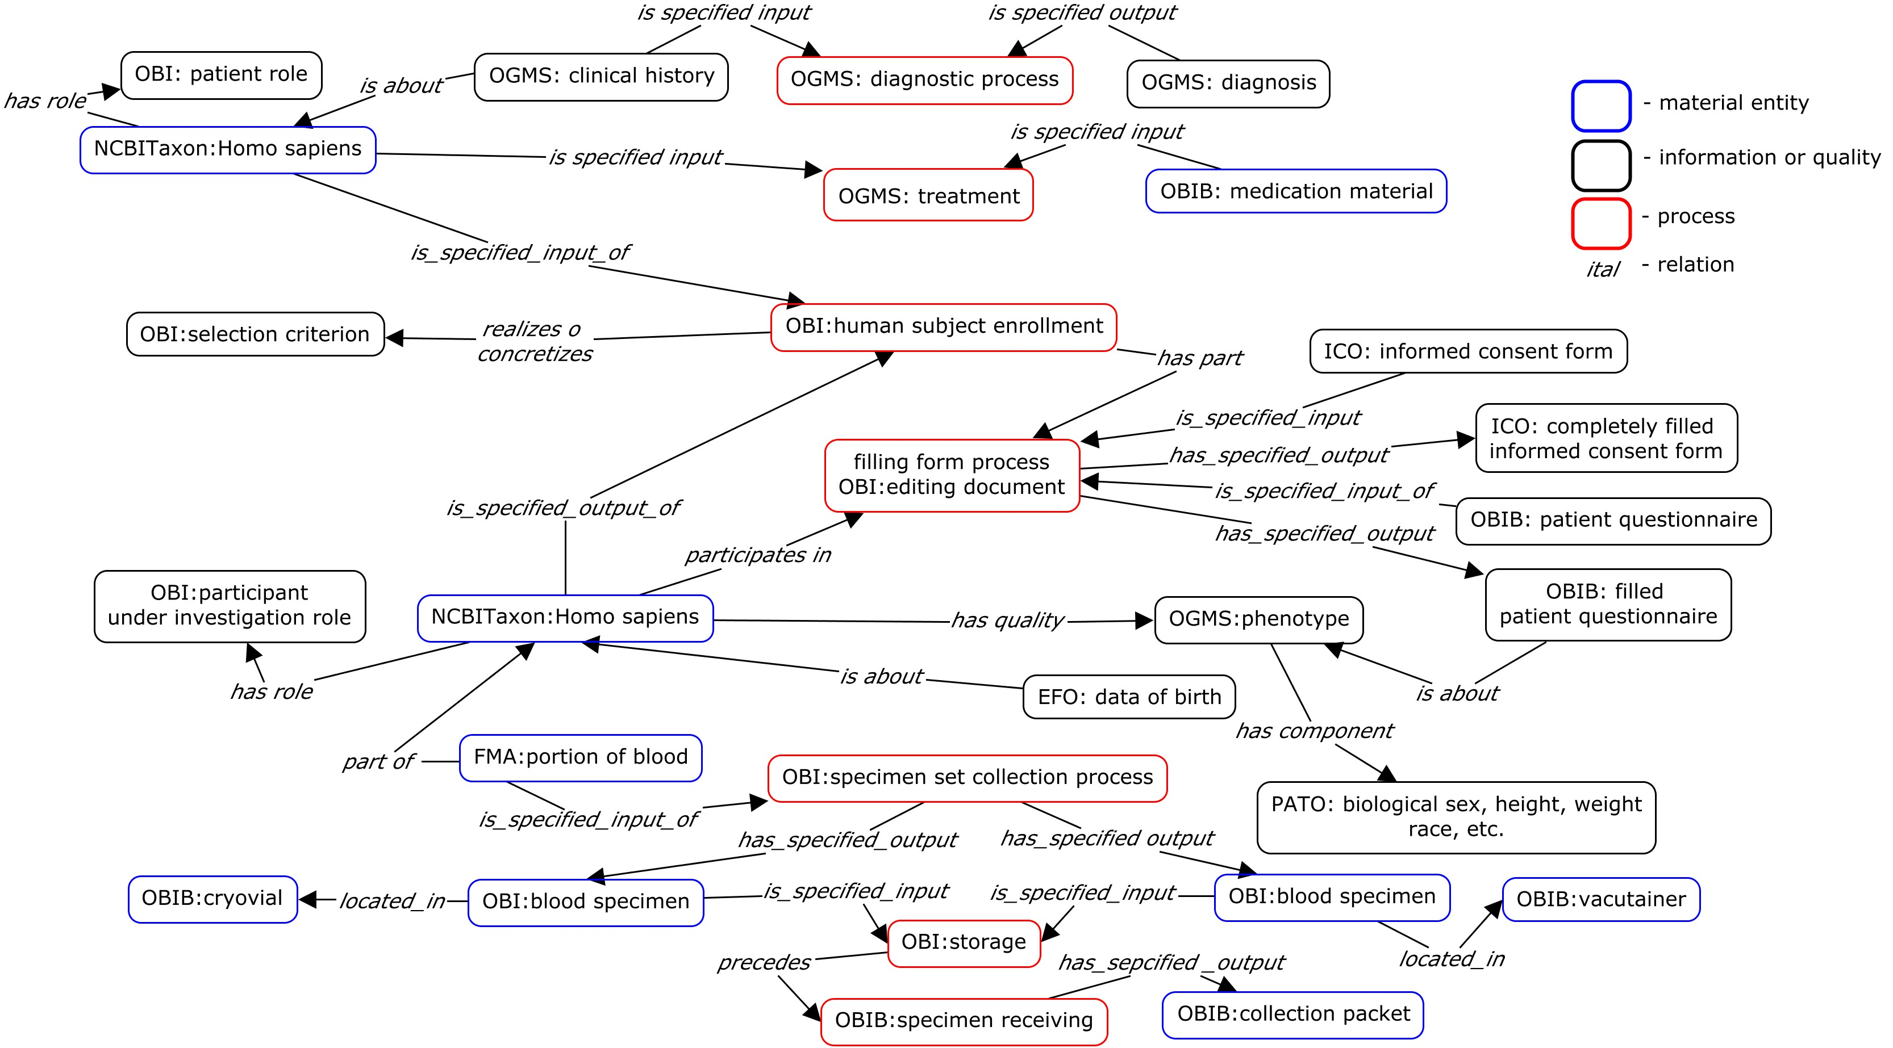
What is an ontology? Definition related to computer science and information science
A controlled vocabulary (names and definitions) and the relationships between them in a specific domain
Ontology is both human readable and machine computable.
Notes:
Helena final
Terminology is linear- a list of terms and defnitions
An ontology connects different objects and terms in a very specific manner
Example of blood sample derived (process) into DNA- ontology models that process and connects the blood to the DNA- not just in a generic way, but with specific attributes

Slide 8
What is an ontology? Definition related to computer science and information science
A controlled vocabulary (names and definitions) and the relationships between them in a specific domain
Ontology is both human readable and machine computable.
Notes:
Helena final
Terminology is linear- a list of terms and defnitions
An ontology connects different objects and terms in a very specific manner
Example of blood sample derived (process) into DNA- ontology models that process and connects the blood to the DNA- not just in a generic way, but with specific attributes

Slide 9

OBO Foundry Ontologies (Jie)
Open Biological and Biomedical Ontologies Foundry
Shared design and modeling principles = Interoperable.
Existing terms in Foundry are reused (no overlap)
Open source
Over 100 reviewed and candidate ontologies available to cover various biological and clinical domains:
Human Disease Ontology: has mapping to ICD 10 code, SNOMED CT
Drug ontology: has mapping to RxNorm ID for drugs
Ontology for Biomedical Investigations: all aspects of an investigation
Notes:
Final- Jie

Slide 10
Foundry Modular Organization (Jie)
top level
mid-level
domain level
application level
Basic Formal Ontology
Information Artifact
Ontology
Ontology for Biomedical
Investigations
Ontology of General
Medical Science
Anatomy Ontology | Infectious Disease Ontology
Sequence Ontology | Phenotypic Quality Ontology
Protein Ontology | Biological Process Ontology
Biobanking Ontology | Vaccination Informed Consent Ontology | Beta Cell Genomic Ontology
Ref: Dr. Barry Smith
Notes:
Final Jie

Slide 11
Main Components and Their Relations in Open Biological and Biomedical Foundry Ontologies
role
investigator role
doctor role
specimen collection
height measurement
weight measurement
BMI calculation
human
blood
specimen
has role
has specified input
material entity
process
has specified output
has specified input
has quality
is about
has specified output
height
weight
information content entity
quality
Last name, first name
6 feet (height)
150 lb (weight)
20.3 (BMI)
is about
Notes:
Central: process
What’s its inputs/outputs
Material entity, collect specimen, blood, blood specimen
Material entity, ICE, assay, blood specimen, glucose concentration in the blood
ICE, ICE, data transformation, glucose concentration in one person, average glucose concentration in a week
Material entity
- Role: patient role, study subject role, reference role
Quality: weight, height
ICE of quality: weight – 50 kg, height 1.6 meter, BMI
ICE of material entity: person name, specimen identifier

Slide 12
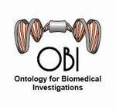
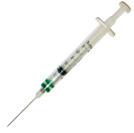
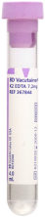
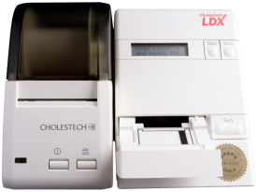

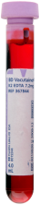
Modeling An Experiment Using
Ontology of Biomedical Investigations (Jie)
Process: specimen collection
Glucometer
Process: Assay
Measurement Datum
1.2 mg/ml
has specified input
has specified input
has specified output
has specified input
has specified input
has specified output
located in
OBI modeling focuses
on processes
Glucose molecules
Blood Specimen
part of
Bandrowski et al. The Ontology for Biomedical Investigations. PLoS One 2016
Notes:
Jie (is this final?)

Slide 13

Today’s Presentation
Self-Introductions
Challenges with (biobanking) data
What is an ontology
questions
Development of biobanking ontology
questions
How to implement
Next steps
Time for questions/ discussion
Notes:
Final Helena

Slide 14

Why Another Standard??
Ontology for biobanking built on other standards Ontology enables interconversion- can talk to other standards
Notes:
Helena-
Need a biobanking standard, but don’t want to create (another new one)

Slide 15
Ontology for Biobanking
Developed on existing work- not created de novo
Ontology for Biomedical Investigations
Use these as building blocks for including new terms
Reuse Foundry Ontologies (e.g. Human Disease Ontology, Drug Ontology)
An application ontology focused specifically on Biobanking domain
Notes:
Final- hELENA

Slide 16
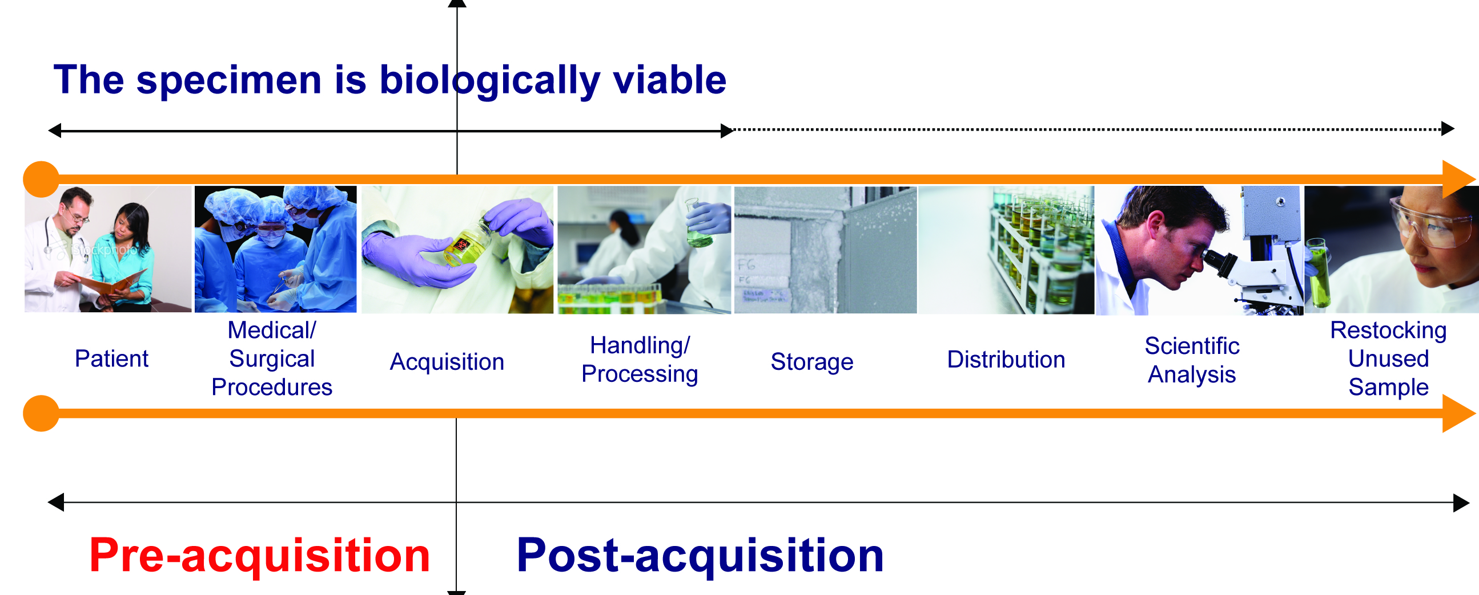
Scope and Purpose
Comprehensive biobanking ontology to enable searching for specimen collections with associated clinical annotation, within and across systems and institutions, that includes essential elements of the biospecimen lifecycle as well as essential elements related to informed consent
Lifecycle of Biospecimen, BBRB of NCI, 2014: Reprinted with permission
Notes:
Helena

Slide 17






Development of Ontology for Biobanking
Initially driven by two independent efforts for capturing different aspects of biobanking.
OMIABIS: Biobank administration-meta data about biobanks (European)
Penn Medicine Biobank use case: patient to specimen tracking use cases
Incorporated
Duke’s biobanking terminology effort (including CBM)
NCI’s The Genotype-Tissue Expression Project (GTEx) terms
MIABIS 2.0 (currently incorporating)
Adding MUSC/UMich informed work on consent ontology
CAP Pre-Analytical variables (Robb et al, 2014)
Notes:
Complete Helena
Ongoing with gtex, tissue specific,

Slide 18
= Biobanking
identifier
patient registry data
information
content entity
data item
informed consent form
document
medical record
role
patient role
questionnaire
patient questionnaire
specimen
bone marrow specimen
processed specimen
buffy coat specimen
processed material
freezer
organization
device
material entity
biobank organization
freezer rack
biobank
gross anatomical part
Organism
Reuse of terms in other Foundry Ontologies and newly added biobanking specific terms
diagnostic process
Treatment
planned
process
human subject enrollment
filling form process
specimen collection
material maintenance
specimen freezing
assay
biological
process (GO)
smoking behavior
Notes:
Final
Helena

Slide 19
Current status of OBIB
Summary statistics for version 2016-09-14
511 terms that annotate biobanking data
89 relationships that connect the biobanking data.
OBIB is open source and is available at:
Github https://github.com/biobanking/biobanking
NCBO Bioportal http://bioportal.bioontology.org/ontologies/OBIB
Ontobee http://www.ontobee.org/browser/index.php?o=OBIB
OBIB Workshop
Notes:
Final Helena workshop link

Slide 20


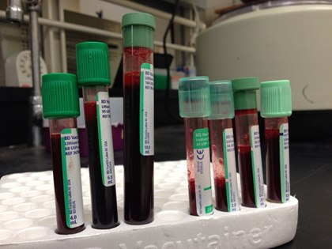
Consent and Collection Processes
Medical/
Surgical
Procedures
Handling/
Processing
Scientific
Analysis
Knowledge
Base
Patient
Acquisition
Storage
Distribution
Human
Consent Process
Participant
Collection Process
Age
Gender
DOB
ICF version
Sample type
Sample volume
Preservative type
Container type
Collection procedure
Date/time signed
Consent to access EMR
Location of process
Consent to donate blood
Person conducting
X
Decline to donate tissue
Notes:
To revise
Helena

Slide 21
Diagnosis, Consent, Collection, Storage, Distribution Processes
Medical/
Surgical
Procedures
Knowledge
Base
Patient
Acquisition
Handling/
Processing
Storage
Distribution
Scientific
Analysis
PROCESS
Notes:
Helena (ask Jie if I missed anything)

Slide 22
Today’s Presentation
Self-Introductions
Challenges with (biobanking) data
What is an ontology
questions
Development of biobanking ontology
questions
How to implement
Next steps
Time for questions/ discussion
Notes:
Final Helena

Slide 23
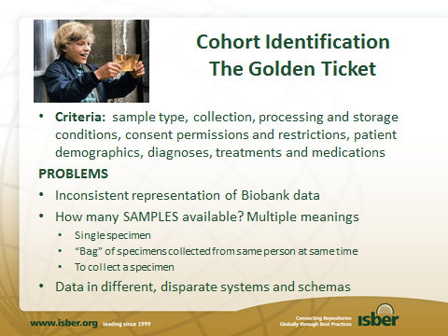
Problems-Ontology Provides Solution
Notes:
Helena (final)

Slide 24
Problems-Ontology Provides Solution
Controlled Vocabulary
Specimen: A material entity that has the specimen role.
specimen family specimens derived from shared ancestor
specimen set specimens collected in one encounter
specimens collected longitudinally: A collection of specimens taken at different time points
Notes:
Helena (final)

Slide 25
Problems-Ontology Provides Solution
Controlled Vocabulary
Specimen: A material entity that has the specimen role.
specimen family specimens derived from shared ancestor
specimen set specimens collected in one encounter
specimens collected longitudinally: A collection of specimens taken at different time points
Query across disparate systems
Keep existing systems
Add a semantic layer (term mapping)
Map to ontology terms
Notes:
Helena (final)

Slide 26
Implementation at UPenn
1
?
?
?
?
?
4
OBI
DRON
DOID
Biobank Ontology Created
Application Ontology
Query
2
R2ML
RDF Conversion
Software
RDF
3
R2RML
RDF Conversion
Software
RDF
Graph Database
Relational
Data
Data from different sources mapped to ontology
OBIB
Ontology for Biobanking
DOID
Disease Ontology
DRON
Drug Ontology
Disparate data and Ontologies are loaded into a database.
1. OBO - Open Biological and Biomedical Ontologies. <http://www.obofoundry.org/>
2. R2RML - RDB to RDF Mapping Language. <http://www.w3.org/2001/sw/rdb2rdf/>
Notes:
Helena (ask Jie?)

Slide 27
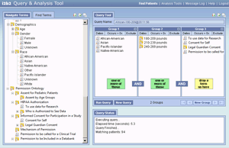


Implementation at MUSC
Biobank LIMS
Combined clinical & biobank research queries
TST123
TST123
TST123
ontology
Consent Data (REDCAP)
Consent to access EMR
ontology
X
Consent to donate blood
Decline to donate tissue
ETL
Clinical Data Warehouse
ETL
EHR source system(s)
i2b2 mart & client

Slide 28
Take Home Message
Comprehensive biobanking ontology enables searching for specimen collections with associated clinical annotation, within and across systems and institutions
Ontology adds standardized semantic layer to different existing systems, such as LabVantage, LIMS, Redcap, data warehouse
Does not require a specific database- can be used in different ways
Can create views into data using i2b2
Notes:
Vendors will ask ‘what do I need to buy or build in order to use the ontology across LIMS/and clinical database systems?
This message goes along with previous slide.
Helena to ask chris if i2b2 can be used, or some other example- jihad send me that figure from the grant? Helena look in the grant
Not sure if this will be it’s own slide, or if this is the message for the previous slide

Slide 29
Future Directions: Provide a framework for collaboration
Extend coverage of OBIB: submit terms and use cases from different biobanks – academia, pharma and vendors
Resubmitting our CTSA Collaborative U01
https://github.com/biobanking/biobanking/issues
Notes:
Helena final
Our approach for development is use case driven

Slide 30
Acknowledgements
University of Pennsylvania
Christian J. Stoeckert Jr., PhD, Jie Zheng, PhD David L. Birtwell, MSE Heather Williams, MSE
Duke University
Helena Ellis, BA, Anna Maria Masci PhD, MS, Ed Hammond, PhD
Medical University of South Carolina
Jihad S. Obeid, MD
University of Arkansas for Medical Sciences
Mathias Brochhausen, PhD
University of Michigan
Frank J. Manion, MS, Marcelline Harris, PhD, RN
National Cancer Institute
Ping Guan, PhD, Helen M Moore, PhD
Samvit Solutions, Reston VA
Lisa Schick, BS
Notes:
Helena final

Slide 31
Thank You Questions/Discussion
Do you find this project useful?
Do vendors see a need or opportunity for their customers?
Do you want to collaborate by contributing your (real life) use case(s)?
Notes:
final

